Slide 1
Budget Sales Analysis

Slide 2
Problem Statement
The objective is to analyze Adventure Works' sales data to identify trends, optimize inventory, and enhance sales strategies. By conducting exploratory data analysis (EDA), we aim to uncover insights that can guide decision-making for improving business performance.
Objective
Understand Sales Trends: Analyze monthly sales trends by category and subcategory.
Optimize Inventory: Identify which products are performing well to make informed inventory decisions.
Enhance Sales Strategies: Use the insights to refine and improve sales strategies.

Slide 3
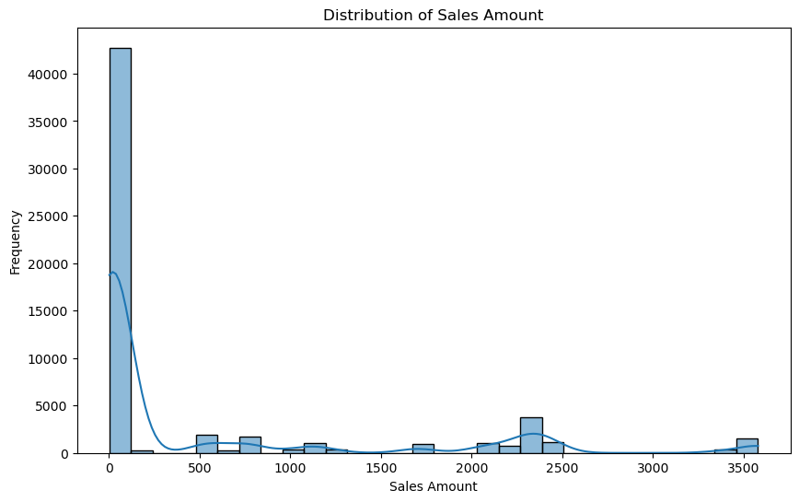
Distribution of Sales Amount

Slide 4
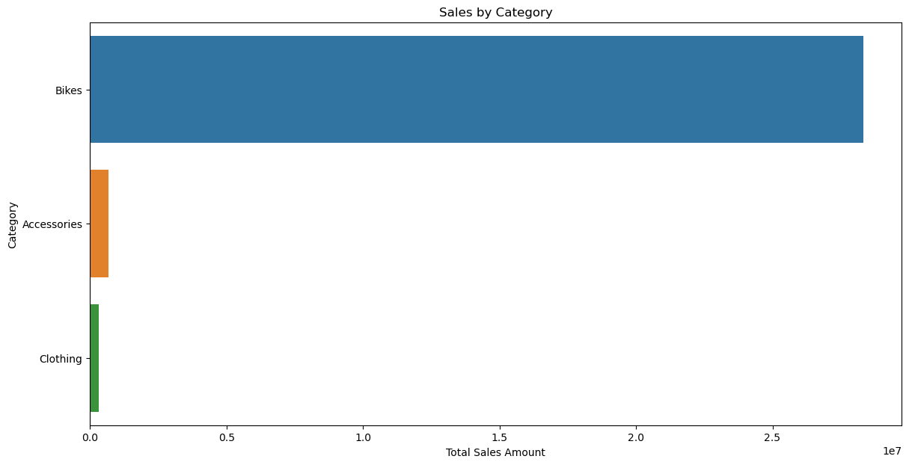
Sales by Category

Slide 5
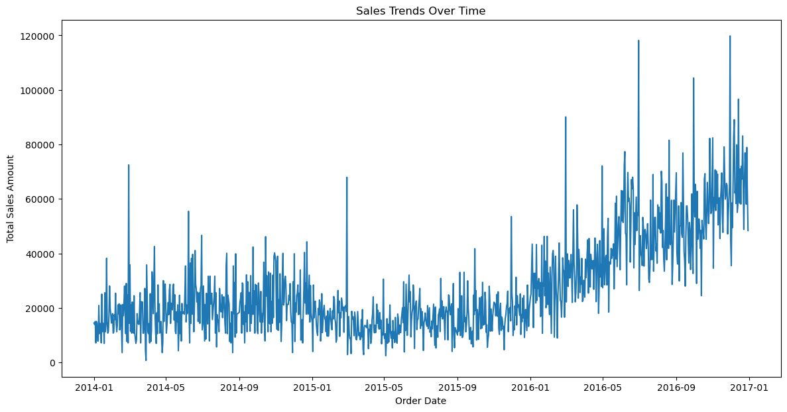
Analyze Sales Trends Over Time

Slide 6
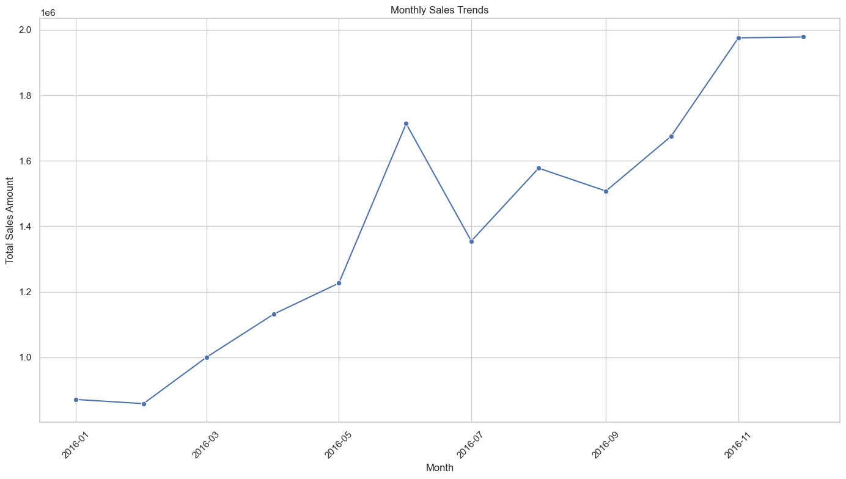
Visualize Monthly Contributions
The chart shows monthly sales trends for 2016:
Steady Increase: Sales generally increased throughout the year.
Peaks: Significant peaks in June and December.
Dips: Notable dips in February and July.
Overall, sales grew consistently with notable peaks mid-year and year-end.

Slide 7
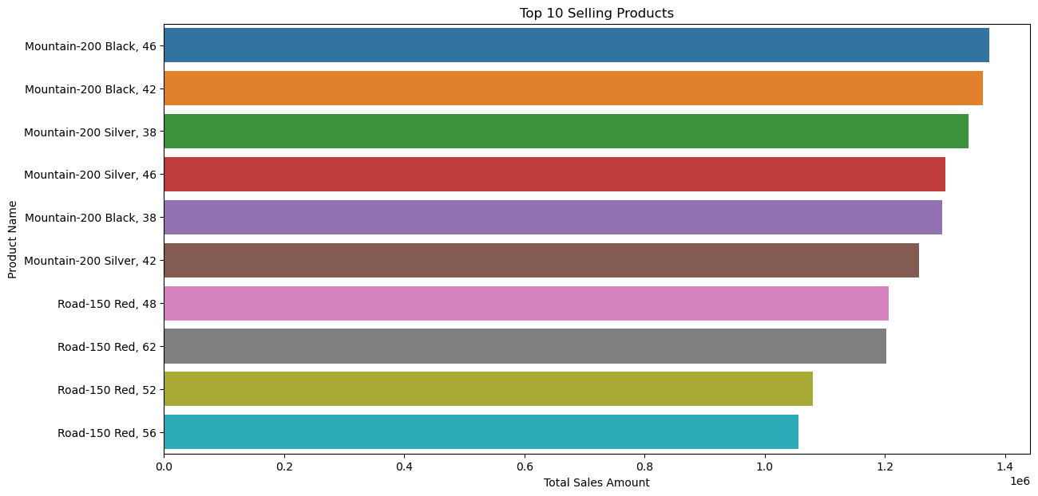
Identify Top-Selling Products

Slide 8
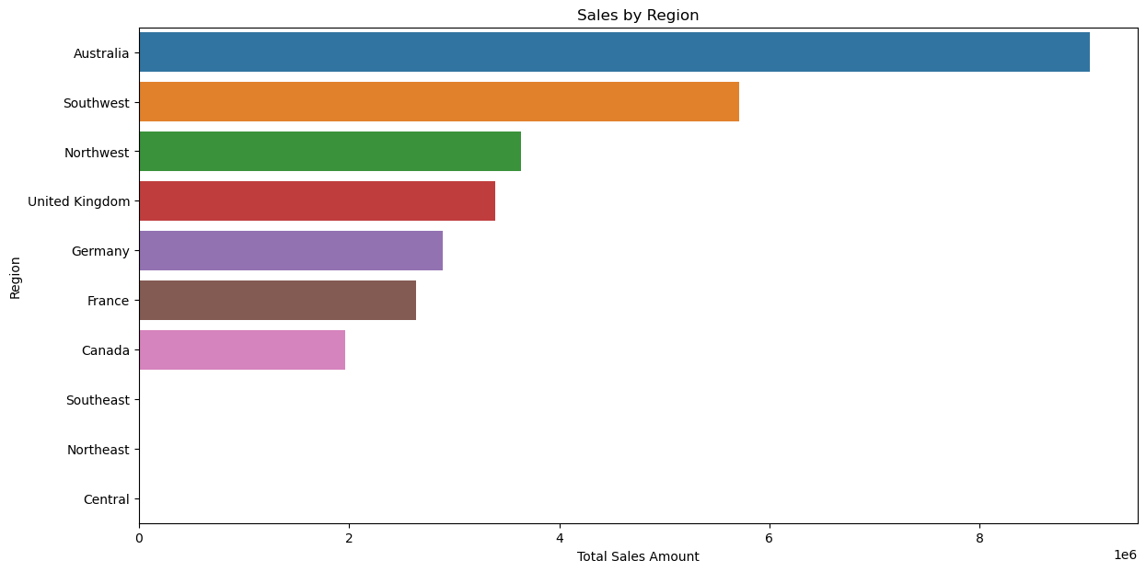
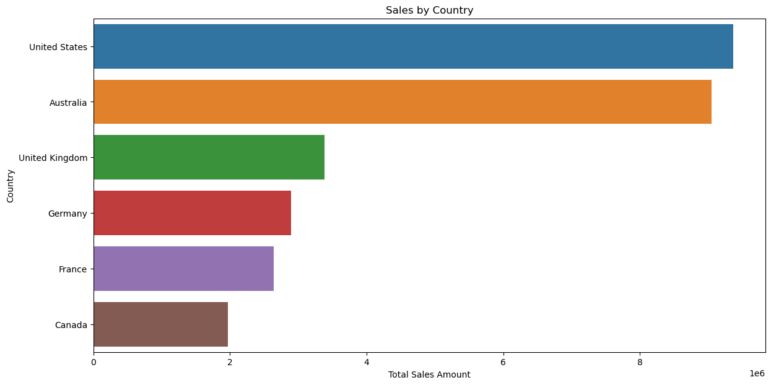
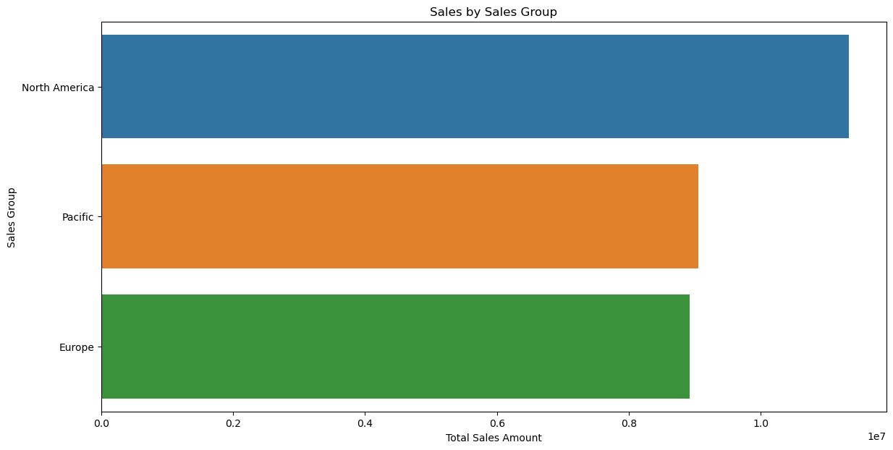
Market Analysis:
Analyzing Sales by Region, Country, and Sales Group

Slide 9
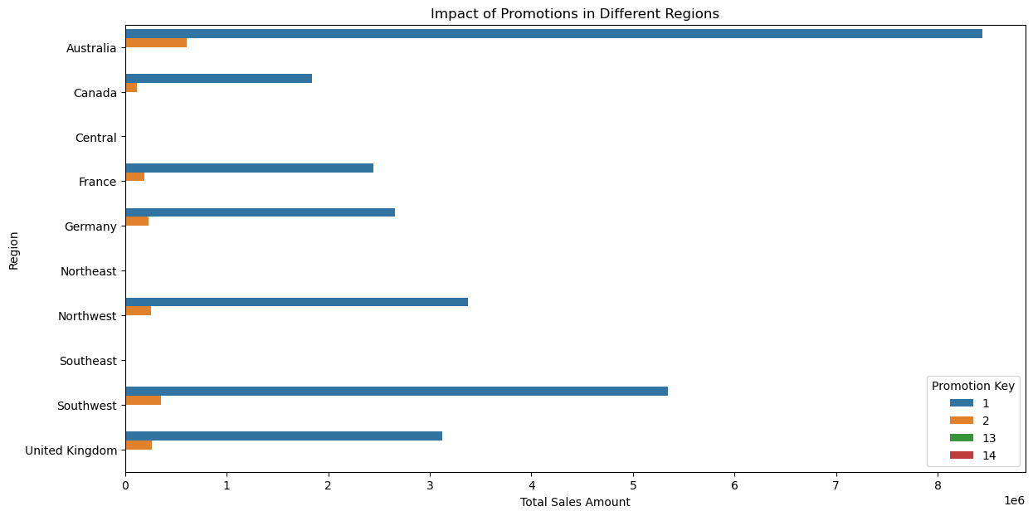
Studying the Impact of Regional Promotions

Slide 10
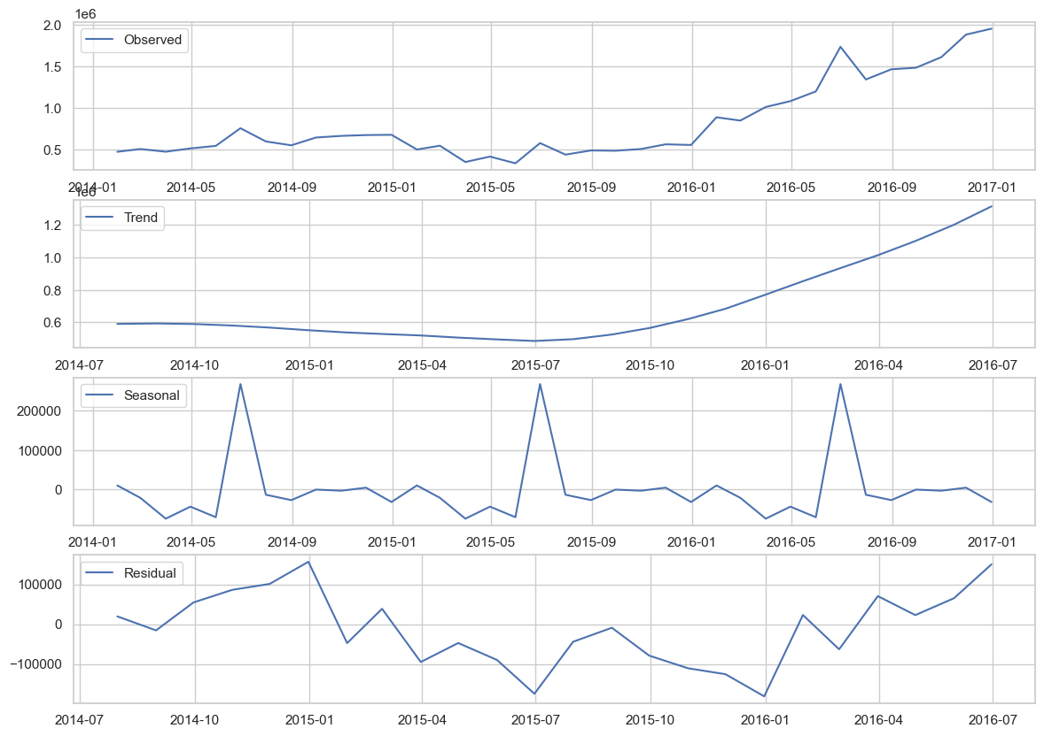
Identifying Seasonal Trends and Patterns
Observed: The overall sales amount, exhibiting growth over time with some fluctuations.
Trend: A consistent upward trend in sales, indicating overall growth.
Seasonal: Repeating patterns indicating seasonality, with peaks around certain times.
Residual: The noise or random fluctuations after removing the trend and seasonal components, showing variability but no clear pattern.

Slide 11
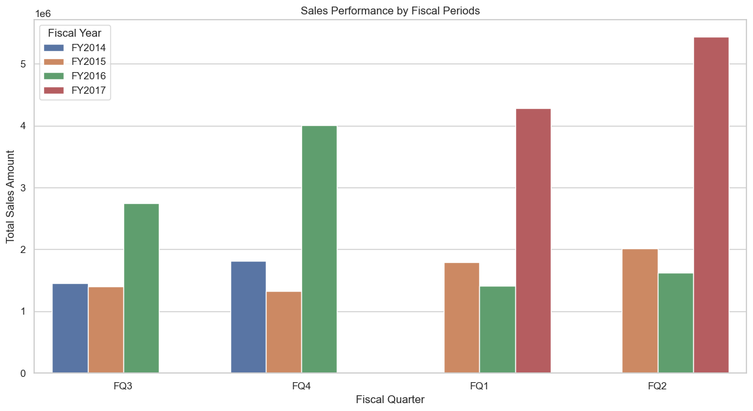
Analyzing Sales Performance by Fiscal Periods

Slide 12
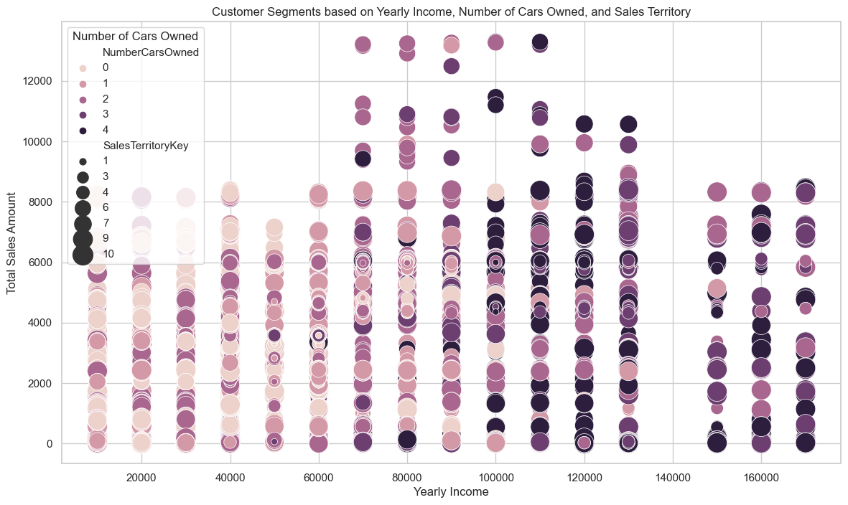
Customer Segmentation Analysis Identify different customer segments based on their purchasing behavior, demographics, and sales territory.
Higher-income customers contribute more to sales, especially those earning above $100,000. Customers with more cars (3 or more) are generally wealthier. Premium customers are distributed across various sales territories.

Slide 13
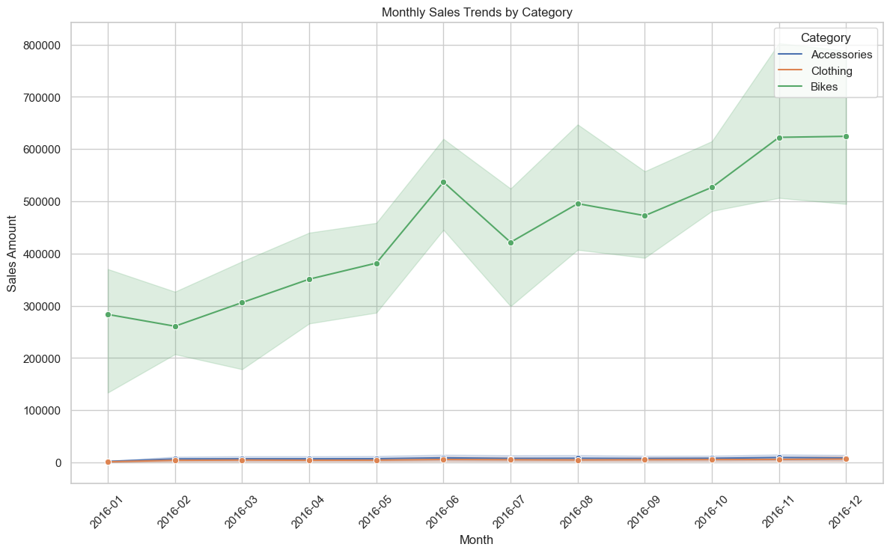
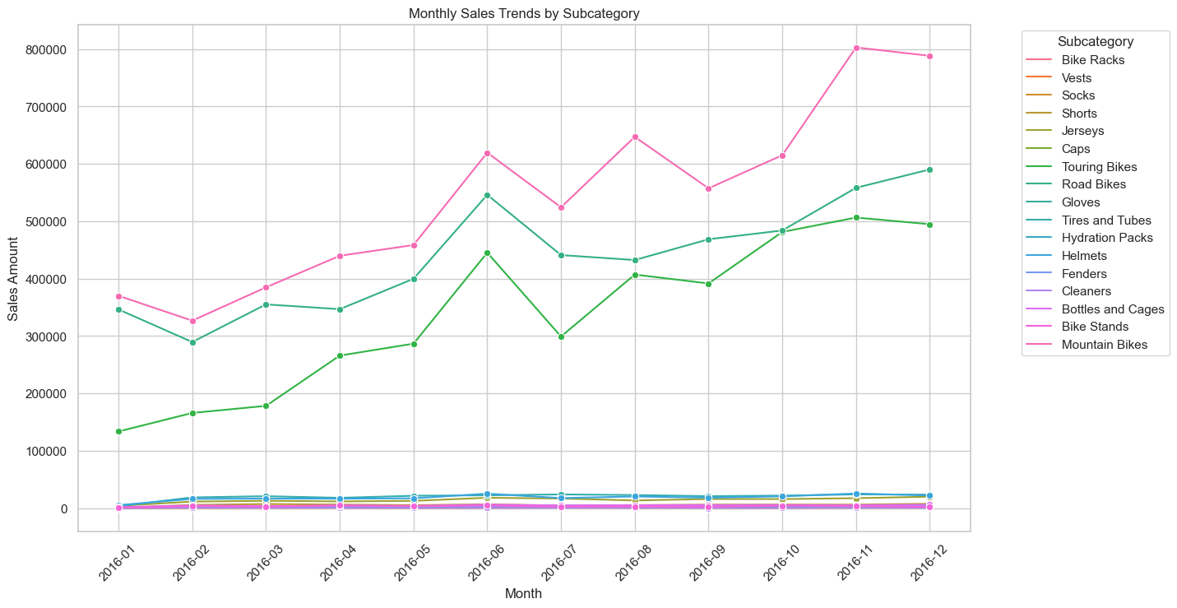
Identifying Seasonal Sales Trends Identify seasonal trends in sales across different product categories and subcategories to optimize inventory and marketing strategies.
Monthly Sales Trends:
- Bikes: Significant upward trend, peaking at 700,000.
- Accessories & Clothing: Flat, lower sales.
- Subcategories: Mountain and Road Bikes dominate with steady growth; other subcategories remain stable with low sales.

Slide 14
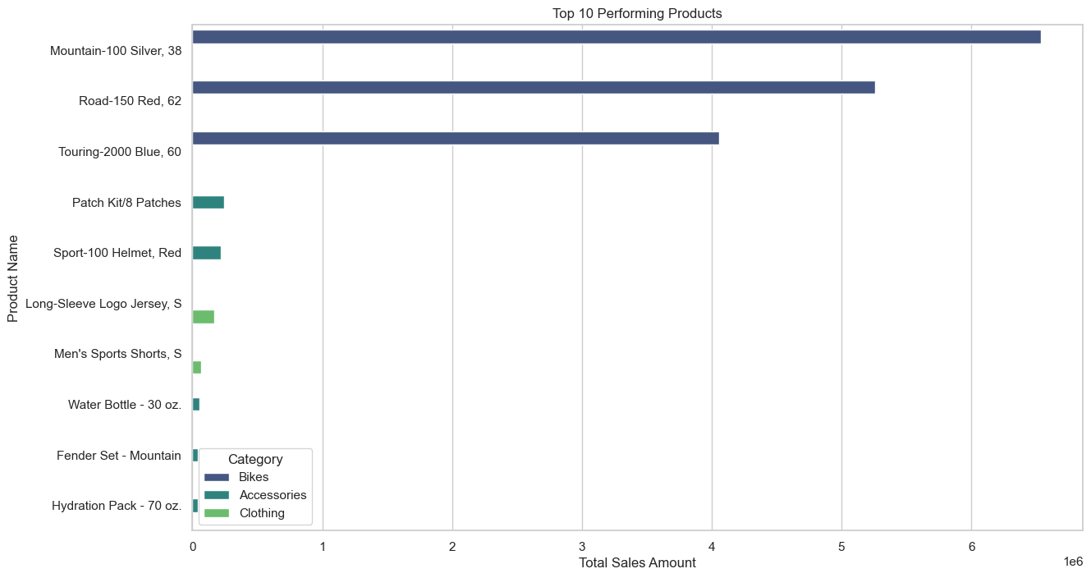
Product Performance Analysis Evaluate the performance of different products to identify top-performing products and those that need marketing or product improvement efforts.

Slide 15
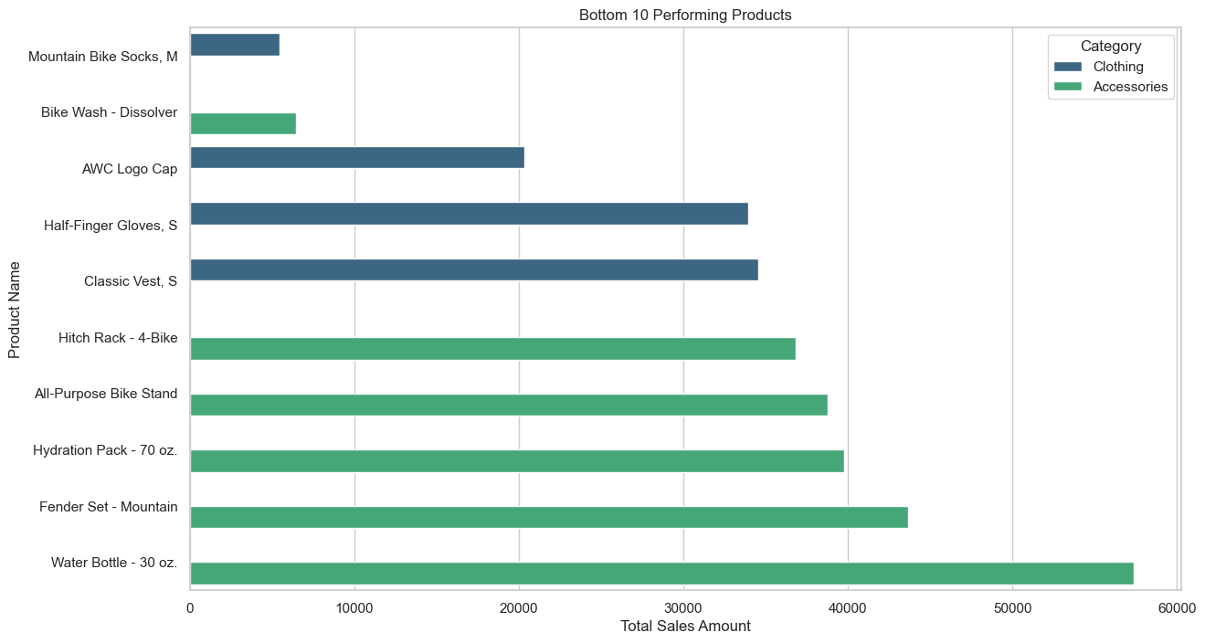

Slide 16
Conclusion
Bikes: Show a significant upward sales trend, indicating strong and growing demand.
Accessories and Clothing: Exhibit relatively flat sales trends with lower sales amounts compared to Bikes.
Mountain and Road Bikes: Dominate sales with consistent growth, especially Mountain Bikes.
Other Subcategories: Remain stable with low sales across the months, without significant spikes or dips.
Overall Impact: The analysis provides actionable insights for optimizing inventory and refining sales strategies to boost overall business performance.

